Slide 1

Cocktails CBR Recommender system
Bejarano Edison
Del Rey Santiago
Reyes Grecia
Zurita Yazmina

Slide 2
TABLE OF CONTENTS
01
05
Proposed solution designing (CBR System)
Methodology
Case base library, retrieval, adapted, evaluation, learning and forgetting.
02
Data domain
06
Evaluation and Results
Manual y Automatic
03
Requirement analysis
07
Conclusion and future works
04
Functional architecture
08
Demo CBR-Cocktails
CBR scheme, System components and interaction sequence

Slide 3
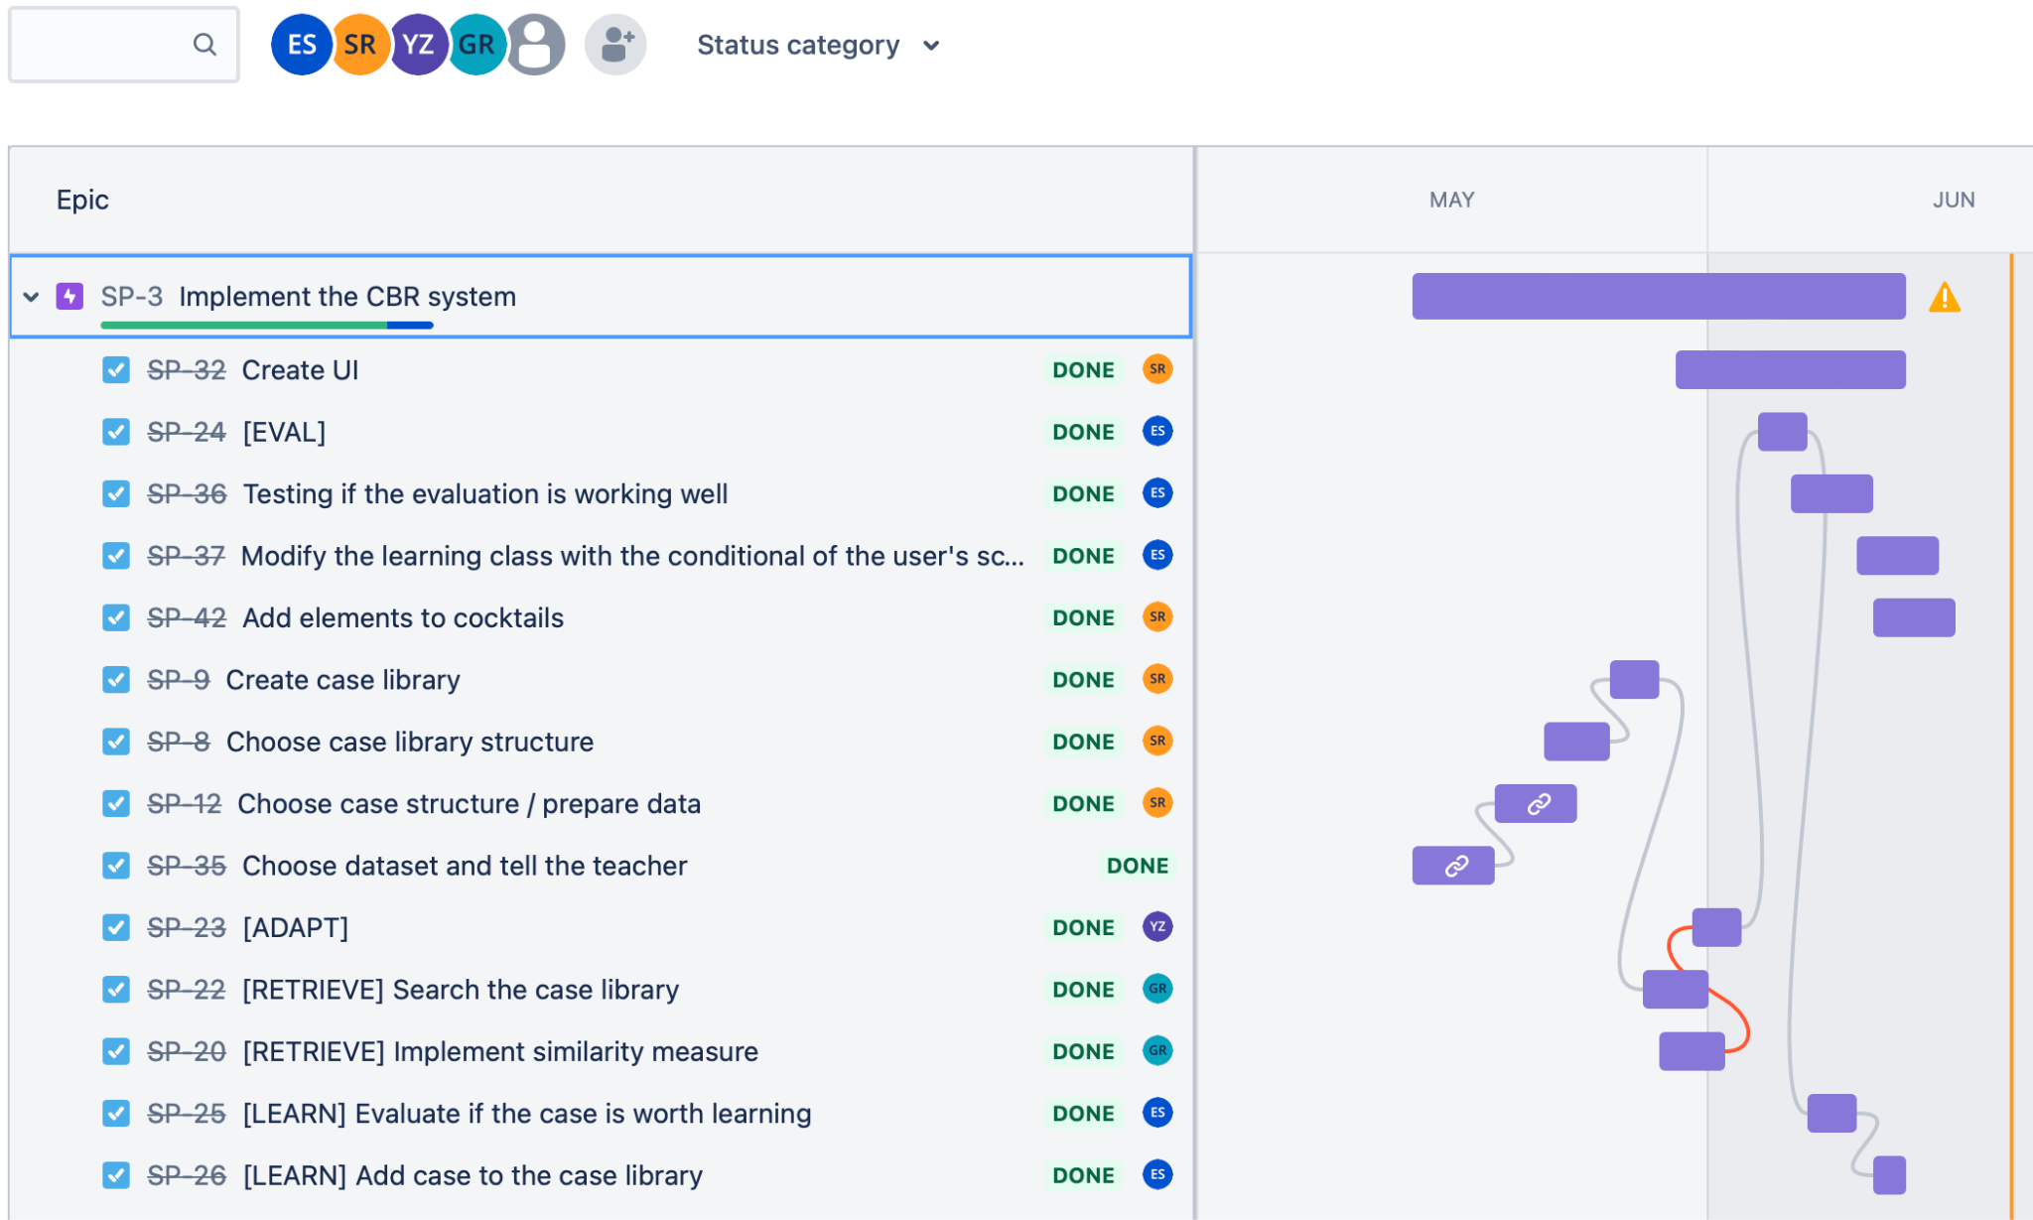
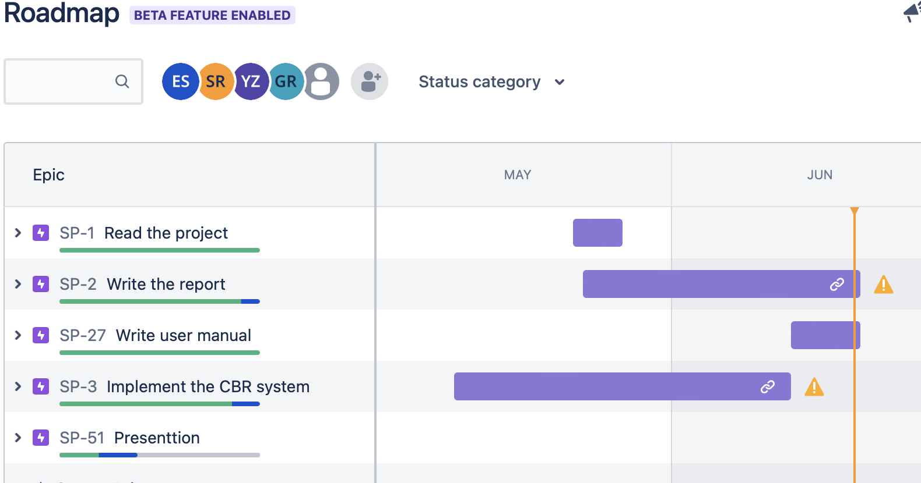
Work group Methodology
Comunication
Daly metings
Agile methodology
Roles
Tools
Scrum master:Santiago
Product Owner: Yazemina
Developer: Grecia
Developer. Edison
Jira
Github
Notes:
As a work strategy, it was decided to use an agile methodology where work roles were assigned.
In
particular, we used a Scrum-like methodology where Yazmina Zurita acted as Product Owner, Santiago
del Rey as Scrum master, and Grecia Reyes and Edison Bejarano as develop

Slide 4
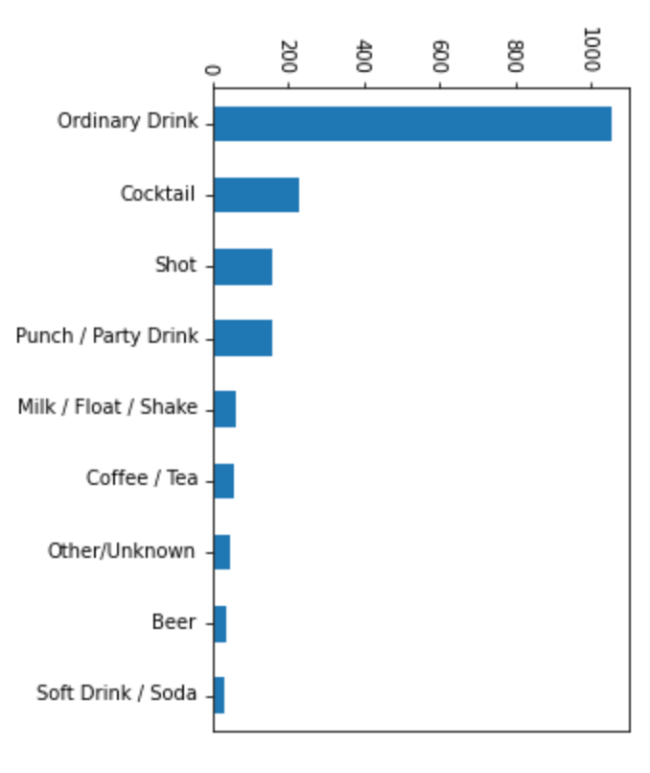
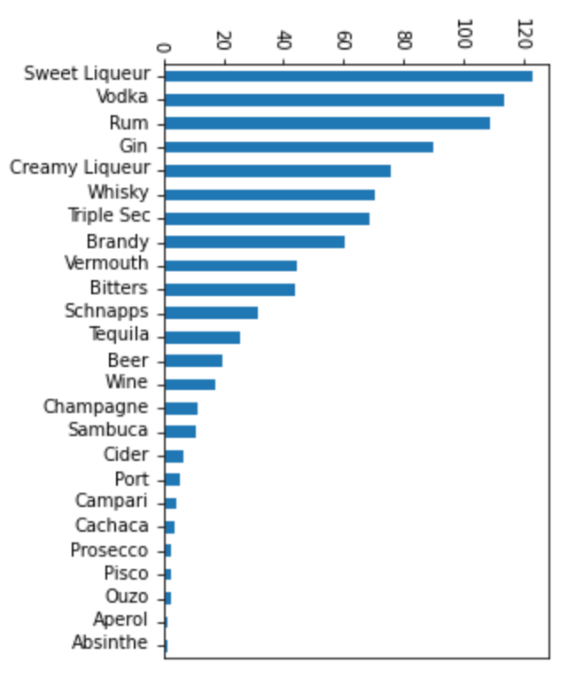
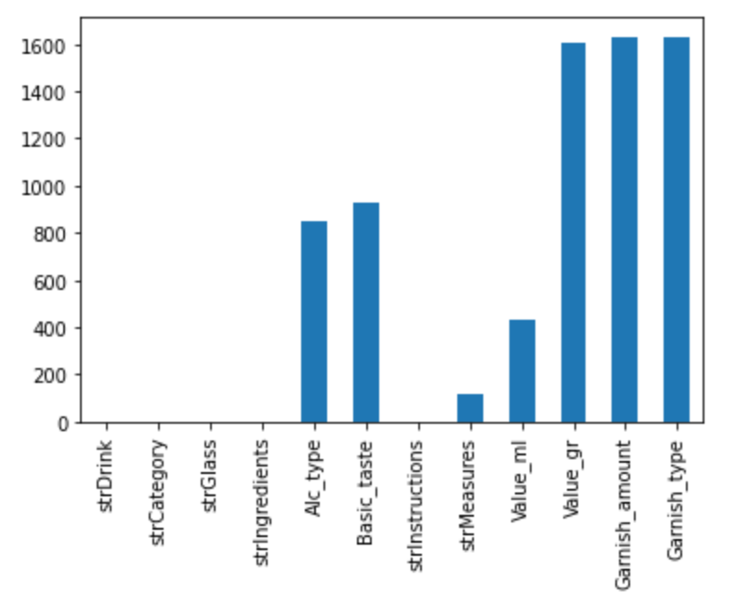
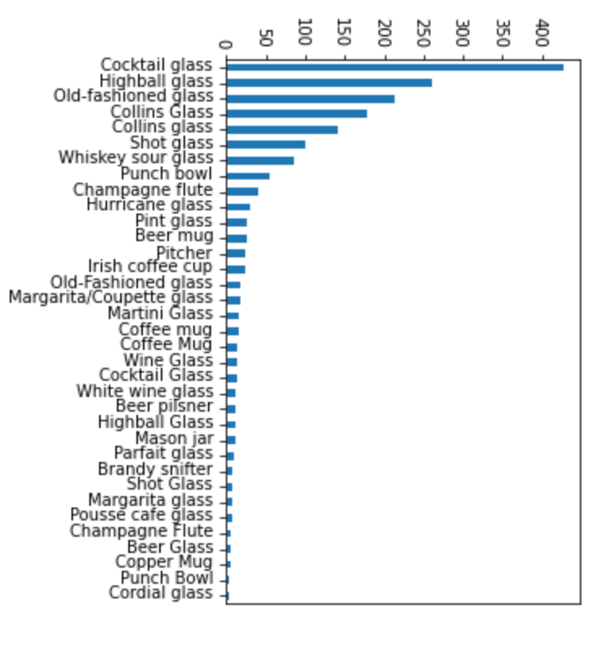
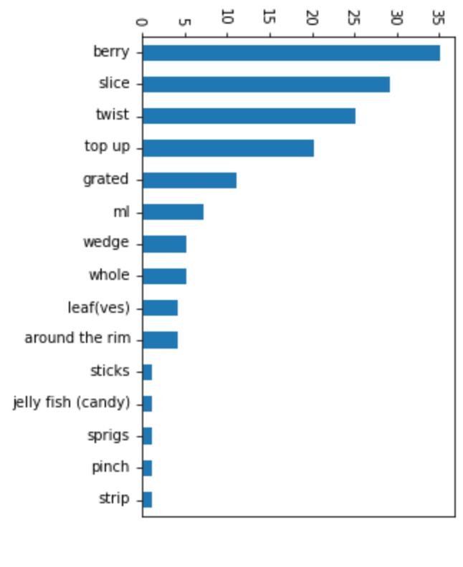
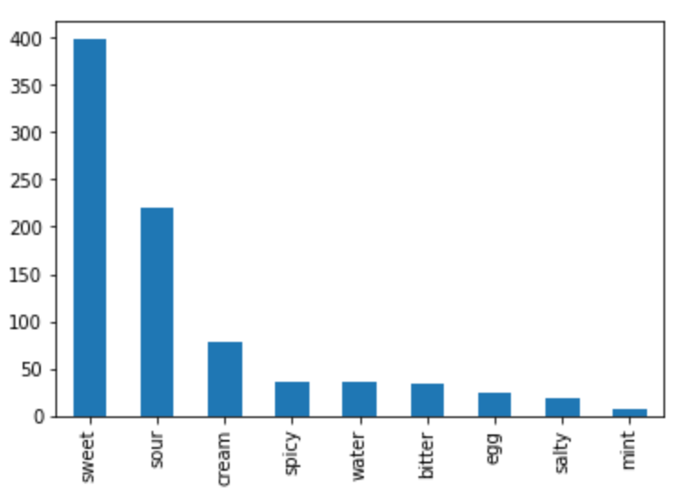
Data domain
473 unique cocktails with each ingredient labeled and measure defined.
Attributes
No
Ingredients | 303
Categories | 9
Alcohol Type | 25
Basic Taste | 9
Glass Type | 35
Garnish type | 15
Notes:
The dataset contains for each cocktail recipe the required ingredients, measurements and cocktail preparation steps.
Organizing the dataset shows that alcohol type, basic taste, measure, quantity, unit and garnish type are attributes of ingredients. Whereas that category and glass type are features referring to the cocktails, this is a cocktail will belong to a single category and will be served in a glass of a certain type

Slide 5
Requirements Analysis
User requirements
Select drink type.
Select glass type.
Include alcohol type.
Include basic taste.
Include ingredients.
Exclude ingredients.
Evaluate recipe.
Technical requirements
Time to process query < 3 seconds.
Size of the case library < 1 GB.
Number of queries before failure > 10.
User friendly.

Slide 6
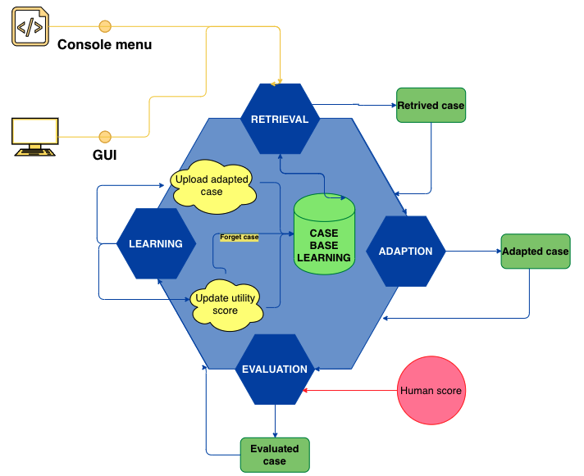
CBR Schema
Venus

Slide 7
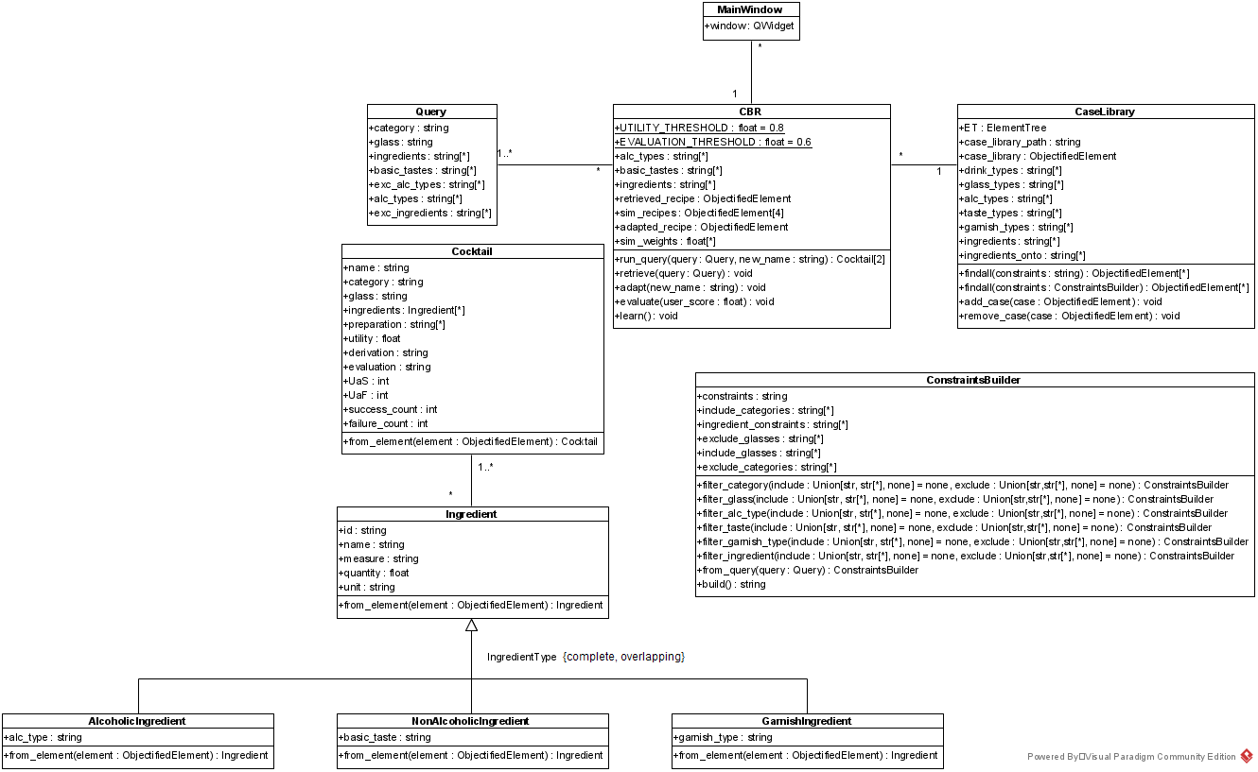
System components

Slide 8
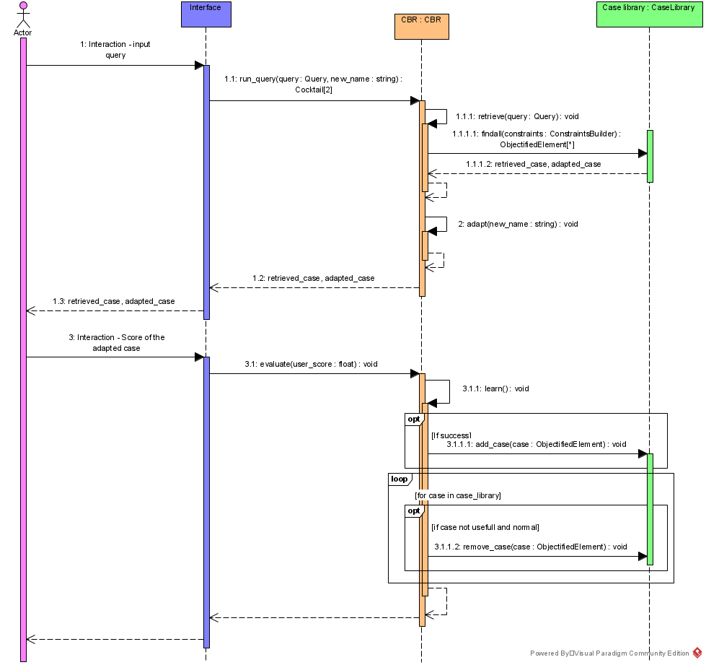
Interaction sequence

Slide 9
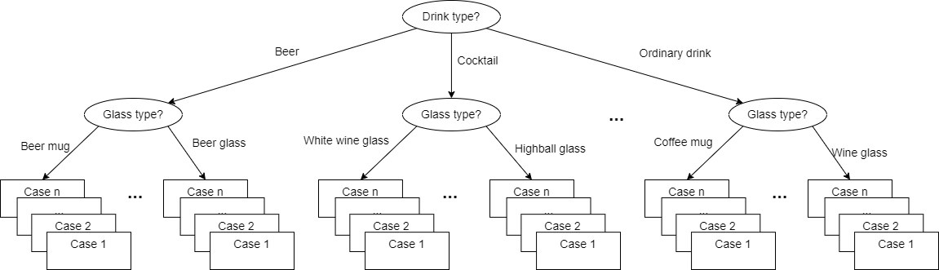
Case representation and Library structure
Case representation
<cocktail>
<name>Snake Bite (UK)</name>
<category>beer</category>
<glass>pint glass</glass>
<ingredients>
<ingredient id="ingr0" alc_type="beer" basic_taste="" measure="1/2 pint" quantity="236.5" unit="ml" garnish_type="">lager</ingredient>
<ingredient id="ingr1" alc_type="wine" basic_taste="" measure="1/2 pint dry" quantity="60.0" unit="ml" garnish_type="">red wine</ingredient>
</ingredients>
<preparation>
<step>pour ingredients into a pint glass</step>
<step>drink</step>
<step>fall over</step>
</preparation>
<utility>1.0</utility>
<derivation>original</derivation>
<evaluation>success</evaluation>
<UaS>0</UaS>
<UaF>0</UaF>
<success_count>0</success_count>
<failure_count>0</failure_count>
</cocktail>
Library structure

Slide 10
CBR System: Retrieval
Searching
Selecting
Pre-select the cases that match with the constraints given by the user in the new case.
The constraints: preferences and exclusions that the user enters in the GUI or in the CL
We will have at least 5 cases retrieved from the case library
Select the most relevant case among the subset retrieved in the previous step.
To calculate the similarity we will define weights w_{k} ∈ [0, 1].
(+) Constraints included: 1, 0.85 y 0.5
(-) Constraints excluded: -1 y -0.5

Slide 11
CBR System: Adaptation
Main methods applied on the adapted recipe:
delete_ingredient:
Remove it from the ingredient list.
Remove it from the steps:
If there is more than one ingredient in the step → placeholder [IGNORE].
If it is the only ingredient in the step, delete the step.
replace_ingredient:
Replace text of one ingredient by the text of another.
include_ingredient:
Add it to the ingredients list with measure = M and id = ingrN.
Insert step in the second position:
If M → “add ingrN”.
Otherwise, “add ingrN to taste”.

Slide 12
CBR System: Adaptation
Input: query of the user, adapted recipe, similar recipes.
Exclude ingredients:
If it is not an alcohol → find ingredient with the same basic_taste and call replace_ingredient (if failure → call delete_ingredient).
If it is an alcohol → call delete_ingredient.
Include ingredients:
Search for the measure and call include_ingredient.
Adapt alcohol types and basic tastes:
Search for an ingredient with the basic_taste or alc_type desired and call include_ingredient.

Slide 13
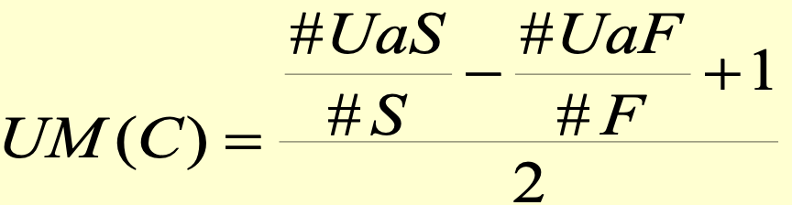
Evaluation - Learning - Forgetting
Evaluation
Getting feedback from the real world
Questioning to a human expert (oracle)
Learning from experience
Learning from success
Storing a new successful case
Update the utility measure of all retrieved cases
Learning from failure
Storing a new failed case
Update the utility measure of all retrieved cases
Forgetting
Utility measure for forgetting
Normalized utility
Notes:
where,
C is a retrieved case
# UaS is the number of times that the case was Used and there was a Success, when the case was among retrieved cases
# S is the total amount of Successes when the case was among retrieved cases
# UaF is the number of times that the case was Used and there was a Failure, when the case was among retrieved cases
# F is the total amount of Failures when the case was among retrieved cases

Slide 14
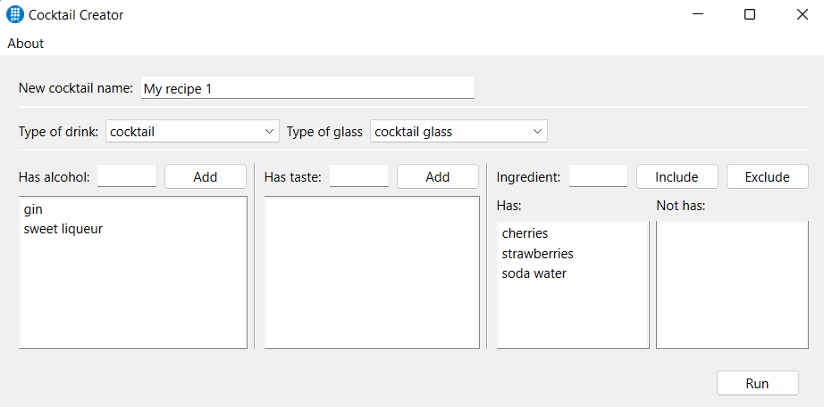
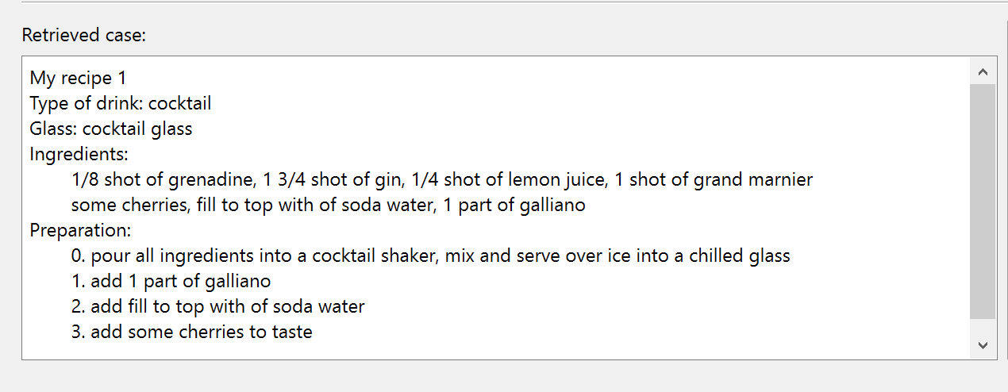
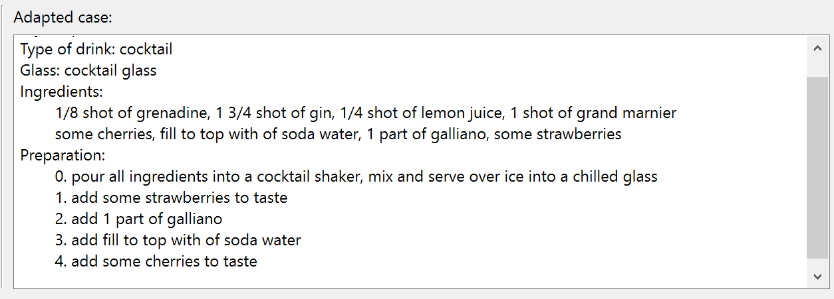
Evaluation and Results: Manual

Slide 15
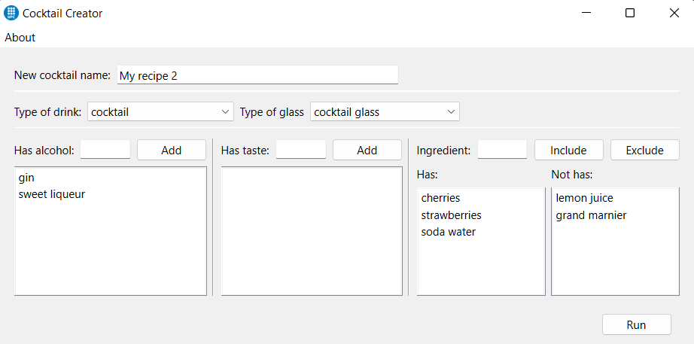
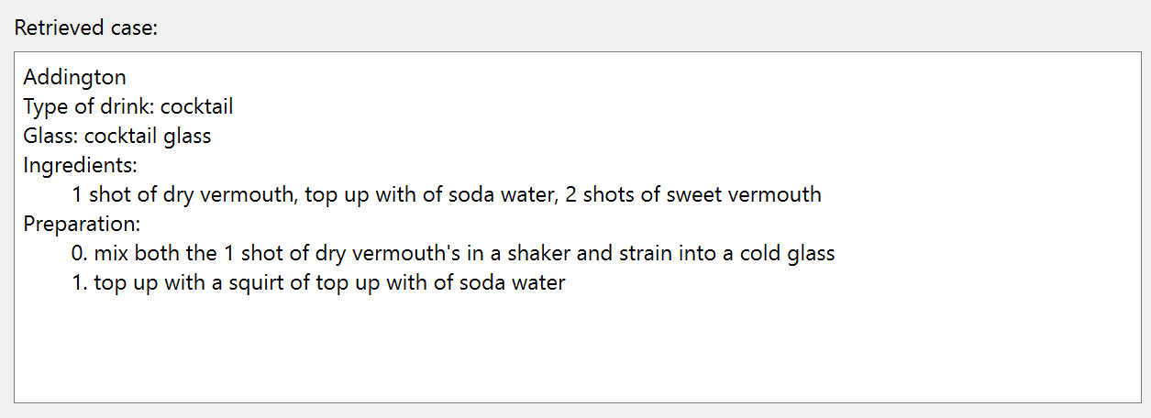
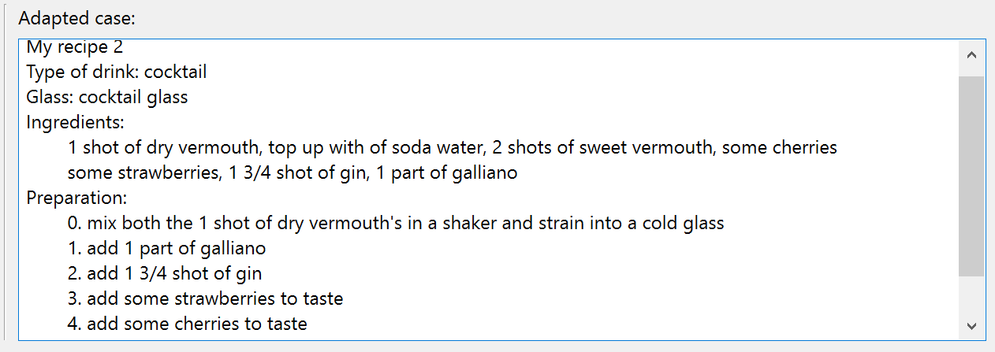
Evaluation and Results: Manual

Slide 16
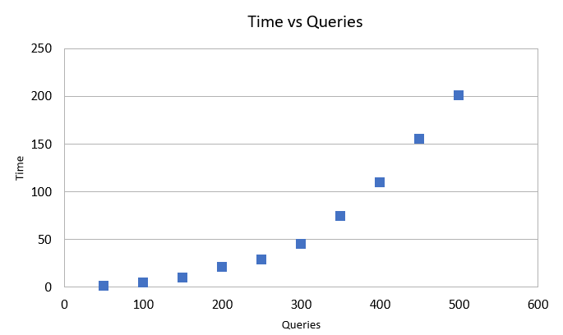
Evaluation and Results: Automatic
test.py script was developed to perform the necessary tests.
Generates a number of queries randomly.
Save: the retrieved case, the adapted recipe generated, the total number of queries and processing time.
(*)11 samples - average
500 queries → 200 sec / 0.4 sec (system should respond less than 3 sec)
Case library 522 kB → executing the tests 3.22 MB

Slide 17
Conclusions and future work
We have implemented a CBR system able to generate cocktail recipes based on user preferences.
The generated recipes satisfy the user constraints.
The system complies with the requirements specified.
Although we have achieved our goal, the solution could be further improved:
Apply NLP techniques to better clean the source dataset.
Explore other methods to learn and forget.
Introduce a measure on how well the user constraints are being met.

